Slide 1
Training Transformers from Scratch
Natural Language Processing with Transformers
Building Language Applications with Hugging Face
이용환

Slide 2
Introduction
Code autocompletion

Slide 3
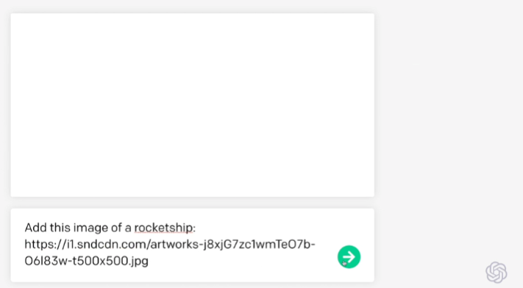
Code autocompletion
AI 기반의 코드 자동 완성 기능
원하는 알고리즘 혹은 소스코드를 자연어로 설명하면 그 설명에 맞는 코드를 추천

Slide 4
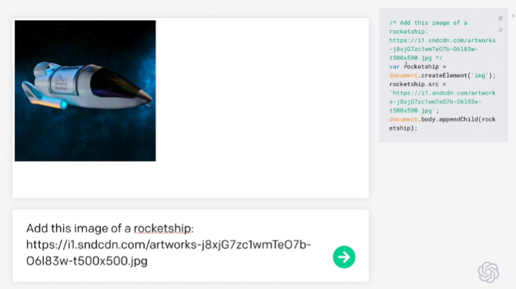
Code autocompletion
AI 기반의 코드 자동 완성 기능
원하는 알고리즘 혹은 소스코드를 자연어로 설명하면 그 설명에 맞는 코드를 추천

Slide 5
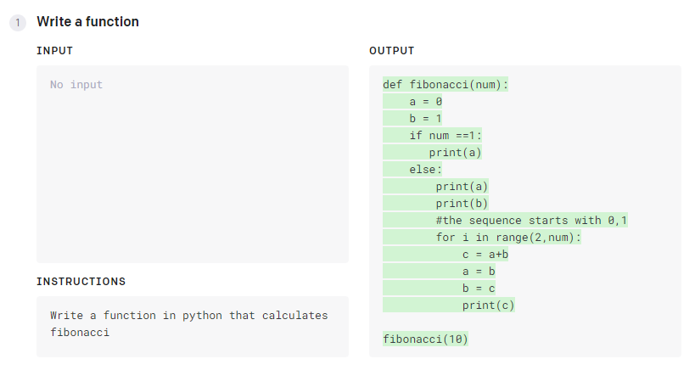
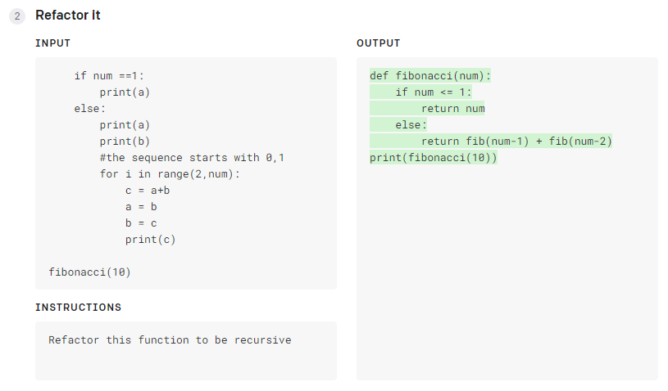
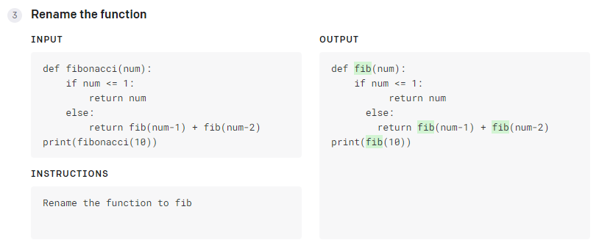
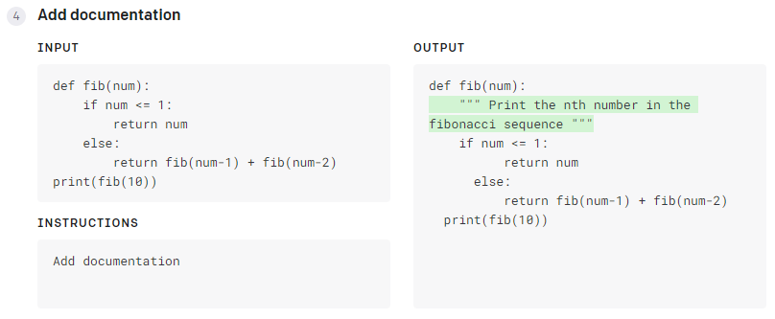
Code autocompletion - OpenAI Codex
OpenAI사의 GPT-3기반 Visual Studio Code용 autocompletion tool(159GB의 Python Code, 5400만개 public github repo)
AI 기반의 코드 자동 완성 기능
원하는 알고리즘 혹은 소스코드를 자연어로 설명하면 그 설명에 맞는 코드를 생성, 수정, 대체, 주석 추가 등

Slide 6
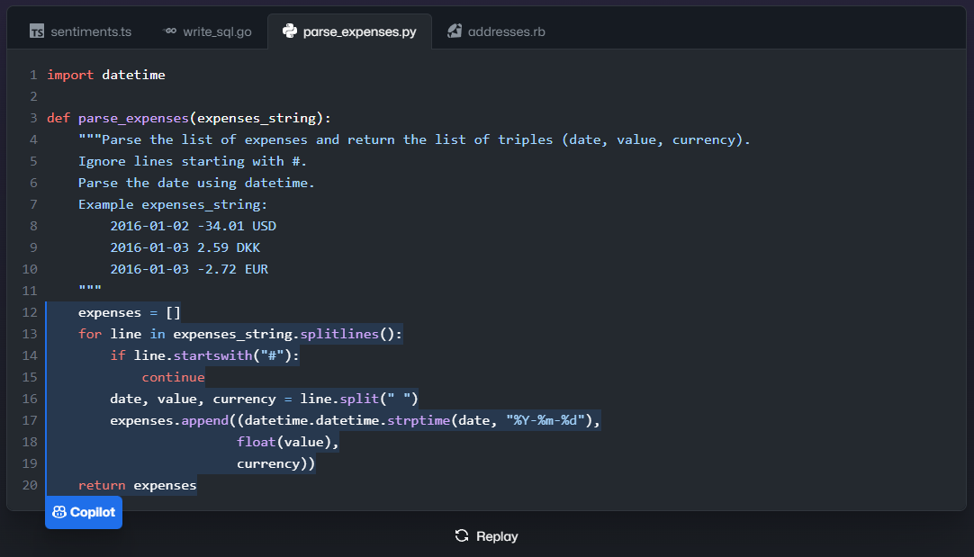
Code autocompletion - GitHub Copilot
GitHub와 OpenAI사의 Codex(GPT-3기반) autocompletion tool(159GB의 Python Code, 5400만개 public github repo)
AI 기반의 코드 자동 완성 기능
원하는 알고리즘 혹은 소스코드를 자연어로 설명하면 그 설명에 맞는 코드를 생성, 수정, 대체, 주석 추가 등

Slide 7
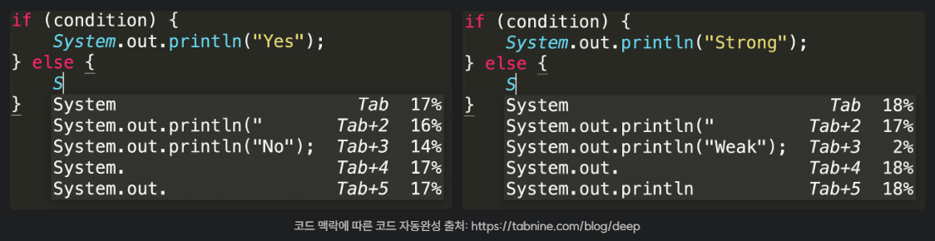
Code autocompletion – TabNine
GPT-3기반 autocompletion tool(public github repo)
AI 기반의 코드 자동 완성 기능
현재까지 작성한 코드의 다음으로 나올 코드를 예측해 추천하는 방식
책의 Chapter 10에서는 이 방식으로 만듦

Slide 8
Custom Dataset
Large dataset and Building a custom code dataset

Slide 9
Challenges of Building a Large-Scale Corpus
Pretraining 후 Model의 quality는 대규모 corpus의 quality에 의한 영향을 크게 받는다.
GPT가 학습한 BookCorpus의 경우, “romance” 장르로 편중되어 있고, GPT-2는 Web pages, blog, news article 등의 data로 pretraining을 진행하였다.
먼저 GPT 모델과 가장 작은 GPT-2 모델의 크기가 대략 비슷함.
Code
from transformers import pipeline, set_seed
generation_gpt = pipeline("text-generation", model="openai-gpt")
generation_gpt2 = pipeline("text-generation", model="gpt2")
def model_size(model):
return sum(t.numel() for t in model.parameters())
print(f"GPT size: {model_size(generation_gpt.model)/1000**2:.1f}M parameters")
print(f"GPT2 size: {model_size(generation_gpt2.model)/1000**2:.1f}M parameters")
Output
GPT size: 116.5M parameters
GPT2 size: 124.4M parameters

Slide 10
Challenges of Building a Large-Scale Corpus
Pretraining 후 Model의 quality는 대규모 corpus의 quality에 의한 영향을 크게 받는다.
GPT가 학습한 BookCorpus의 경우, “romance” 장르로 편중되어 있고, GPT-2는 Web pages, blog, news article 등의 data로 pretraining을 진행하였다.
크기가 비슷한 GPT 모델과 가장 작은 GPT-2 모델이 다른 Dataset으로부터 생성하는 문장 확인
Code
set_seed(1)
def enum_pipeline_ouputs(pipe, prompt, num_return_sequences):
out = pipe(prompt, num_return_sequences=num_return_sequences,
clean_up_tokenization_spaces=True)
return "\n".join(f"{i+1}." + s["generated_text"] for i, s in enumerate(out))
prompt = "\nWhen they came back"
print("GPT completions:\n" + enum_pipeline_ouputs(generation_gpt, prompt, 3))
print("")
print("GPT-2 completions:\n" + enum_pipeline_ouputs(generation_gpt2, prompt, 3))

Slide 11
Challenges of Building a Large-Scale Corpus
Output
GPT completions:
1.
When they came back.
" we need all we can get, " jason said once they had settled into the back of the truck without anyone stopping them. " after getting out here, it 'll be up to us what to find. for now
2.
When they came back.
his gaze swept over her body. he 'd dressed her, too, in the borrowed clothes that she 'd worn for the journey.
" i thought it would be easier to just leave you there. " a woman like
3.
When they came back to the house and she was sitting there with the little boy.
" don't be afraid, " he told her. she nodded slowly, her eyes wide. she was so lost in whatever she discovered that tom knew her mistake
GPT-2 completions:
1.
When they came back we had a big dinner and the other guys went to see what their opinion was on her. I did an hour and they were happy with it.
2.
When they came back to this island there had been another massacre, but he could not help but feel pity for the helpless victim who had been left to die, and that they had failed that day. And so was very, very grateful indeed.
3.
When they came back to our house after the morning, I asked if she was sure. She said, "Nope." The two kids were gone that morning. I thought they were back to being a good friend.
When Dost

Slide 12
Challenges of Building a Large-Scale Corpus
Output
GPT completions:
1.
When they came back.
" we need all we can get, " jason said once they had settled into the back of the truck without anyone stopping them. " after getting out here, it 'll be up to us what to find. for now
2.
When they came back.
his gaze swept over her body. he 'd dressed her, too, in the borrowed clothes that she 'd worn for the journey.
" i thought it would be easier to just leave you there. " a woman like
3.
When they came back to the house and she was sitting there with the little boy.
" don't be afraid, " he told her. she nodded slowly, her eyes wide. she was so lost in whatever she discovered that tom knew her mistake
GPT-2 completions:
1.
When they came back we had a big dinner and the other guys went to see what their opinion was on her. I did an hour and they were happy with it.
2.
When they came back to this island there had been another massacre, but he could not help but feel pity for the helpless victim who had been left to die, and that they had failed that day. And so was very, very grateful indeed.
3.
When they came back to our house after the morning, I asked if she was sure. She said, "Nope." The two kids were gone that morning. I thought they were back to being a good friend.
When Dost
Romantic interaction
Adventure-related elements

Slide 13
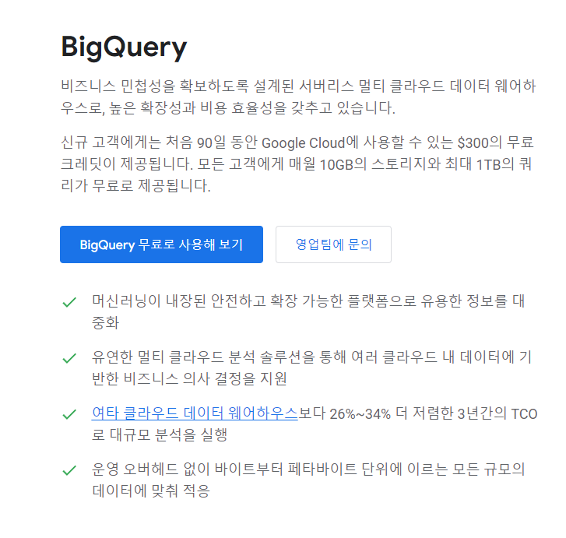
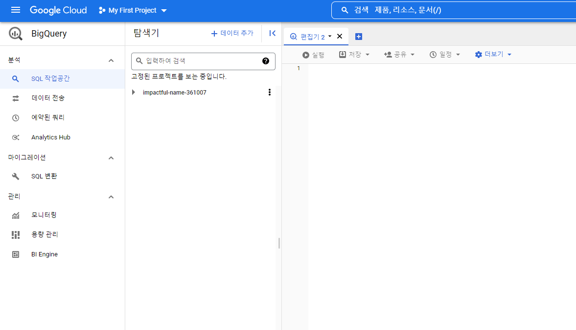
Building a Custom Code Dataset
책에서는 Python code generation model을 위한 Dataset을 만들기로 함.
Github repository에서 source code data를 얻고, Google BigQuery를 활용하기로 함.

Slide 14
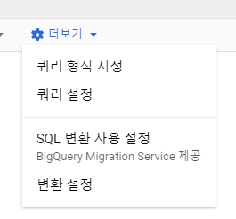
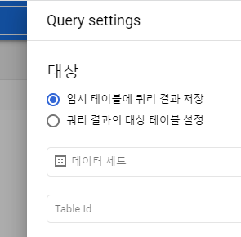
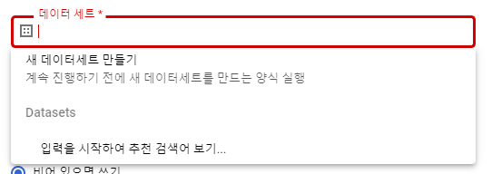
Building a Custom Code Dataset
책에서는 Python code generation model을 위한 Dataset을 만들기로 함.
Github repository에서 source code data를 얻고, Google BigQuery를 활용하기로 함.

Slide 15
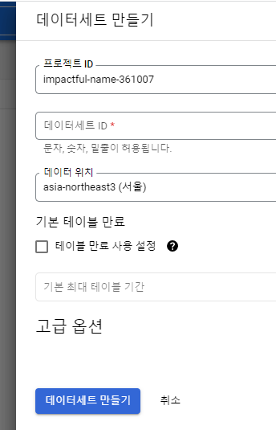
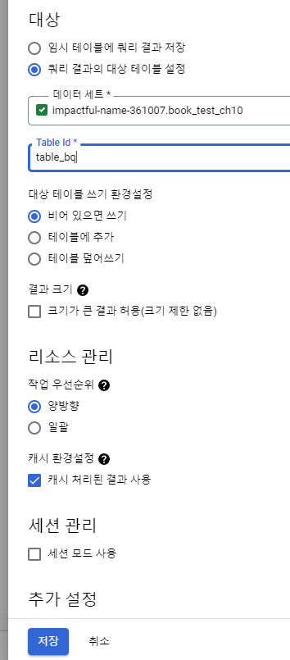
Building a Custom Code Dataset
책에서는 Python code generation model을 위한 Dataset을 만들기로 함.
Github repository에서 source code data를 얻고, Google BigQuery를 활용하기로 함.

Slide 16
Building a Custom Code Dataset
책에서는 Python code generation model을 위한 Dataset을 만들기로 함.
Github repository에서 source code data를 얻고, Google BigQuery를 활용하기로 함.
Code
SELECT
f.repo_name, f.path, c.copies, c.size, c.content, l.license
FROM
`bigquery-public-data.github_repos.files` AS f
JOIN
`bigquery-public-data.github_repos.contents` AS c
ON
f.id = c.id
JOIN
`bigquery-public-data.github_repos.licenses` AS l
ON
f.repo_name = l.repo_name
WHERE
NOT c.binary
AND ((f.path LIKE '%.py')
AND (c.size BETWEEN 1024
AND 1048575))

Slide 17
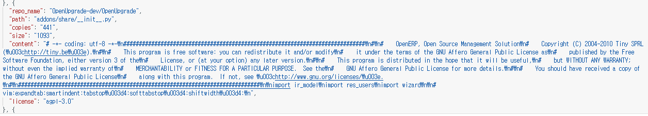
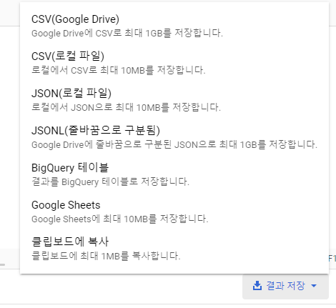
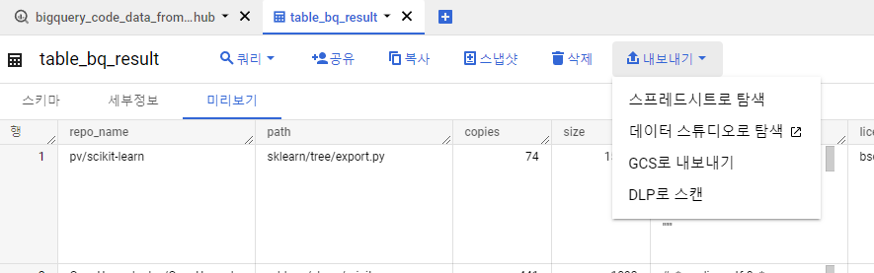
Building a Custom Code Dataset
Output

Slide 18
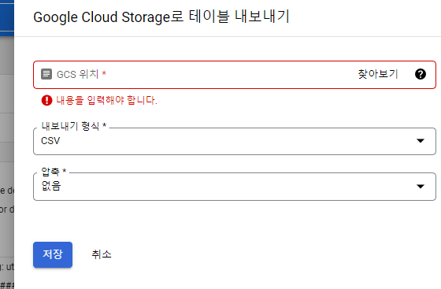
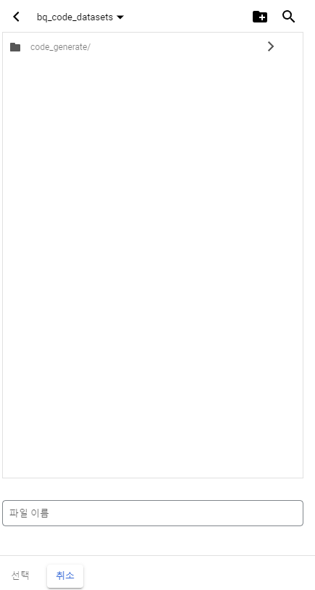
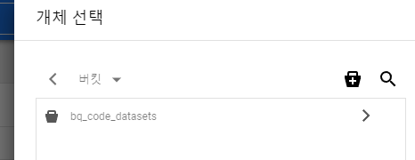
Building a Custom Code Dataset
JSON

Slide 19
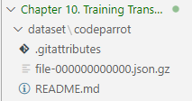
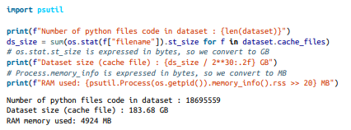
Building a Custom Code Dataset
‘내보내기’ 후에 gsutil 설치(pip install gsutil)
gsutil config에 Google 계정 등록 -> bucket을 컴퓨터에 copy
혹은 제일 간단한 방법 : “git clone https://huggingface.co/datasets/transformersbook/codeparrot”
위 사진과 같이 file-000000000000.json.gz부터 499번까지 총 183.68GB

Slide 20
Building a Tokenizer

Slide 21
Building a Tokenizer
Code
# hide_output
from transformers import AutoTokenizer
def tok_list(tokenizer, string):
input_ids = tokenizer(string, add_special_tokens=False)["input_ids"]
return [tokenizer.decode(tok) for tok in input_ids]
tokenizer_T5 = AutoTokenizer.from_pretrained("t5-base")
tokenizer_camembert = AutoTokenizer.from_pretrained("camembert-base")
print(f'T5 tokens for "sex": {tok_list(tokenizer_T5,"sex")}')
print(f'CamemBERT tokens for "being": {tok_list(tokenizer_camembert,"being")}')
Output
T5 tokens for "sex": ['', 's', 'ex']
CamemBERT tokens for "being": ['be', 'ing']

Slide 22
Building a Tokenizer
Code
from transformers import AutoTokenizer
python_code = r"""def say_hello():
print("Hello, World!")
# Print it
say_hello()
"""
tokenizer = AutoTokenizer.from_pretrained("gpt2")
print(tokenizer(python_code).tokens())
Output
['def', 'Ġsay', '_', 'hello', '():', 'Ċ', 'Ġ', 'Ġ', 'Ġ', 'Ġprint', '("', 'Hello', ',', 'ĠWorld', '!"', ')', 'Ċ', '#', 'ĠPrint', 'Ġit', 'Ċ', 'say', '_', 'hello', '()', 'Ċ']

Slide 23
Building a Tokenizer
Code
tokenizer.backend_tokenizer.normalizer
Output
None
현재 어떤 방식으로 normalize되어 있는지 확인
GPT-2 Tokenizer는 normalization을 사용하지 않았음.

Slide 24
Building a Tokenizer
Code
a, e = u"a", u"€"
byte = ord(a.encode("utf-8"))
print(f'`{a}` is encoded as `{a.encode("utf-8")}` with a single byte: {byte}')
byte = [ord(chr(i)) for i in e.encode("utf-8")]
print(f'`{e}` is encoded as `{e.encode("utf-8")}` with three bytes: {byte}')
Output
`a` is encoded as `b'a'` with a single byte: 97
`€` is encoded as `b'\xe2\x82\xac'` with three bytes: [226, 130, 172]
Byte level로 글자를 Tokenization할 때, 어떤 식으로 숫자로 표현되는지 확인
Ex) a -> b‘a’(UTF-8로 표현) -> 97

Slide 25
Building a Tokenizer
Code
from transformers.models.gpt2.tokenization_gpt2 import bytes_to_unicode
byte_to_unicode_map = bytes_to_unicode()
unicode_to_byte_map = dict((v, k) for k, v in byte_to_unicode_map.items())
base_vocab = list(unicode_to_byte_map.keys())
print(f'Size of our base vocabulary: {len(base_vocab)}')
print(f'First element: `{base_vocab[0]}`, last element: `{base_vocab[-1]}`')
Output
Size of our base vocabulary: 256
First element: `!`, last element: `Ń`
Byte level로 글자를 Tokenization할 때, 어떤 식으로 숫자로 표현되는지 확인
Ex) a -> b‘a’(UTF-8로 표현) -> 97

Slide 26
Building a Tokenizer
Code
import pandas as pd
from transformers.models.gpt2.tokenization_gpt2 import bytes_to_unicode
byte_to_unicode_map = bytes_to_unicode()
unicode_to_byte_map = dict((v, k) for k, v in byte_to_unicode_map.items())
base_vocab = list(unicode_to_byte_map.keys())
examples = [
['Regular characters', '`a` and `?`', f'{ord("a")} and {ord("?")}' , f'`{byte_to_unicode_map[ord("a")]}` and `{byte_to_unicode_map[ord("?")]}`'],
['Nonprintable control character (carriage return)', '`U+000D`', f'13', f'`{byte_to_unicode_map[13]}`'],
['A space', '` `', f'{ord(" ")}', f'`{byte_to_unicode_map[ord(" ")]}`'],
['A nonbreakable space', '`\\xa0`', '160', f'`{byte_to_unicode_map[ord(chr(160))]}`'],
['A newline character', '`\\n`', '10', f'`{byte_to_unicode_map[ord(chr(10))]}`'],
]
pd.DataFrame(examples, columns = ['Description', 'Character', 'Bytes', 'Mapped bytes'])

Slide 27
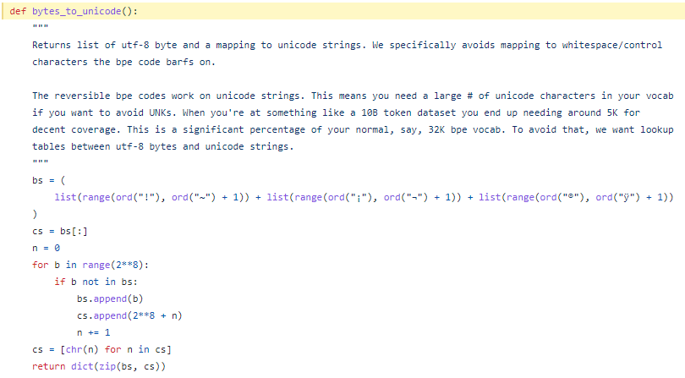
Building a Tokenizer
[33 ~ 126, 161 ~ 255]
{33: '!', 34: '“', … , 173: 'Ń'}

Slide 28
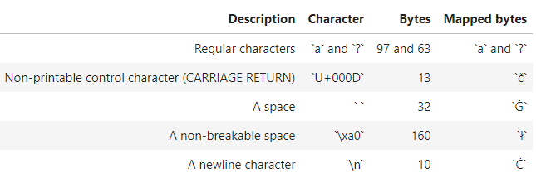
Building a Tokenizer
Output

Slide 29
Building a Tokenizer
Code
print(tokenizer.backend_tokenizer.pre_tokenizer.pre_tokenize_str(python_code))
Output
[('def', (0, 3)), ('Ġsay', (3, 7)), ('_', (7, 8)), ('hello', (8, 13)), ('():', (13, 16)), ('ĊĠĠĠ', (16, 20)), ('Ġprint', (20, 26)), ('("', (26, 28)), ('Hello', (28, 33)), (',', (33, 34)), ('ĠWorld', (34, 40)), ('!")', (40, 43)), ('Ġ#', (43, 45)), ('ĠPrint', (45, 51)), ('Ġit', (51, 54)), ('Ċ', (54, 55)), ('Ċ', (55, 56)), ('say', (56, 59)), ('_', (59, 60)), ('hello', (60, 65)), ('()', (65, 67)), ('Ċ', (67, 68))]
Code
print(f"Size of the vocabulary: {len(tokenizer)}")
Output
Size of the vocabulary: 50257
Code
print(tokenizer(python_code).tokens())
Output
['def', 'Ġsay', '_', 'hello', '():', 'Ċ', 'Ġ', 'Ġ', 'Ġ', 'Ġprint', '("', 'Hello', ',', 'ĠWorld', '!"', ')', 'Ġ#', 'ĠPrint', 'Ġit', 'Ċ', 'Ċ', 'say', '_', 'hello', '()', 'Ċ']
최종적으로 tokenizer().tokens로 토큰화 확인

Slide 30
Training a Tokenizer
Code
tokens = sorted(tokenizer.vocab.items(), key=lambda x: len(x[0]), reverse=True)
print([f'{tokenizer.convert_tokens_to_string(t)}' for t, _ in tokens[:8]])
Output
['ÃÂÃÂÃÂÃÂÃÂÃÂÃÂÃÂÃÂÃÂÃÂÃÂÃÂÃÂÃÂÃÂÃÂÃÂÃÂÃÂÃÂÃÂÃÂÃÂÃÂÃÂÃÂÃÂÃÂÃÂÃÂÃÂ’,
' =================================================================‘,
' ----------------------------------------------------------------’,
'................................................................’,
'ÃÂÃÂÃÂÃÂÃÂÃÂÃÂÃÂÃÂÃÂÃÂÃÂÃÂÃÂÃÂÃÂ’,
'----------------------------------------------------------------', '================================================================', '________________________________________________________________']
Code
tokens = sorted(tokenizer.vocab.items(), key=lambda x: x[1], reverse=True)
print([f'{tokenizer.convert_tokens_to_string(t)}' for t, _ in tokens[:12]])
Output
['<|endoftext|>', ' gazed', ' informants', ' Collider', ' regress', 'ominated', ' amplification', 'Compar', '…."', ' (/', 'Commission', ' Hitman']

Slide 31
Training a Tokenizer
Code
from tqdm.auto import tqdm
length = 100000
dataset_name = 'transformersbook/codeparrot-train'
dataset = load_dataset(dataset_name, split="train", streaming=True)
iter_dataset = iter(dataset)
def batch_iterator(batch_size=10):
for _ in tqdm(range(0, length, batch_size)):
yield [next(iter_dataset)['content'] for _ in range(batch_size)]
new_tokenizer = tokenizer.train_new_from_iterator(batch_iterator(),
vocab_size=12500,
initial_alphabet=base_vocab)

Slide 32
Training a Tokenizer
Code
import keyword
print(f'There are in total {len(keyword.kwlist)} Python keywords.')
for keyw in keyword.kwlist:
if keyw not in new_tokenizer.vocab:
print(f'No, keyword `{keyw}` is not in the vocabulary')
Output
There are in total 35 Python keywords.
No, keyword `await` is not in the vocabulary
No, keyword `finally` is not in the vocabulary
No, keyword `nonlocal` is not in the vocabulary
Code
length = 200000
new_tokenizer_larger = tokenizer.train_new_from_iterator(batch_iterator(),
vocab_size=32768, initial_alphabet=base_vocab)

Slide 33
Training a Tokenizer
Code
tokens = sorted(new_tokenizer_larger.vocab.items(), key=lambda x: x[1], reverse=False)
print([f'{tokenizer.convert_tokens_to_string(t)}' for t, _ in tokens[-12:]])
Output
['lineEdit', 'spik', ' BC', 'pective', 'OTA', 'theus', 'FLUSH', ' excutils', '00000002', ' DIVISION', 'CursorPosition', ' InfoBar']
Code
print(new_tokenizer_larger(python_code).tokens())
Output
['def', 'Ġsay', '_', 'hello', '():', 'ĊĠĠĠ', 'Ġprint', '("', 'Hello', ',', 'ĠWorld', '!")', 'Ġ#', 'ĠPrint', 'Ġit', 'Ċ', 'Ċ', 'say', '_', 'hello', '()', 'Ċ']
Code
for keyw in keyword.kwlist:
if keyw not in new_tokenizer_larger.vocab:
print(f'No, keyword `{keyw}` is not in the vocabulary')
Output
No, keyword `nonlocal` is not in the vocabulary

Slide 34
Training a Model from Scratch

Slide 35
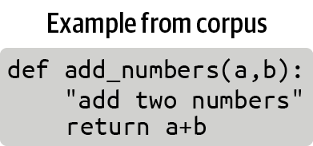
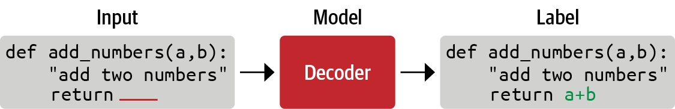
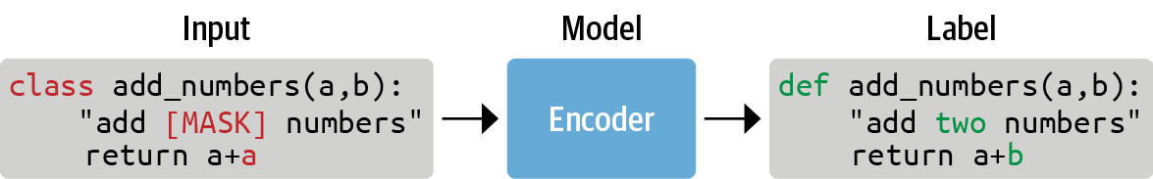
Training a Model from Scratch

Slide 36
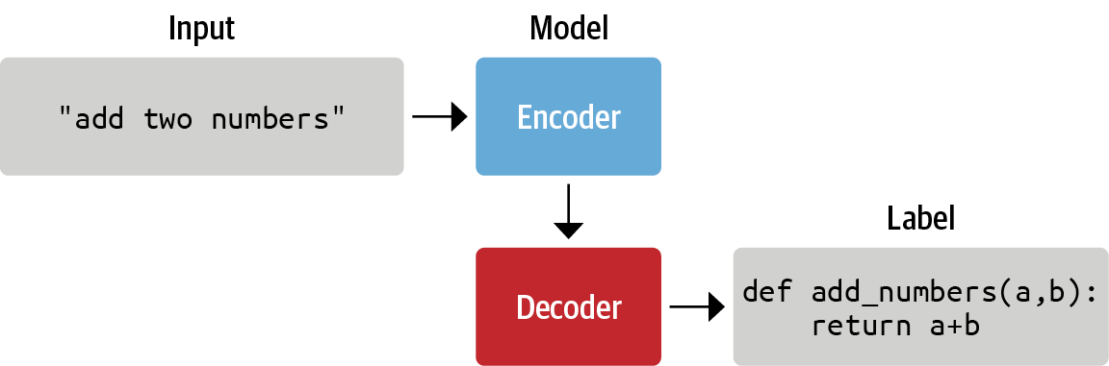
Training a Model from Scratch

Slide 37
Training a Model from Scratch
Code
class ConstantLengthDataset(IterableDataset):
def __init__(self, tokenizer, dataset, seq_length=1024,
num_of_sequences=1024, chars_per_token=3.6):
self.tokenizer = tokenizer
self.concat_token_id = tokenizer.eos_token_id
self.dataset = dataset
self.seq_length = seq_length
self.input_characters = seq_length * chars_per_token * num_of_sequences
def __iter__(self):
iterator = iter(self.dataset)
more_examples = True
while more_examples:
buffer, buffer_len = [], 0
while True:
if buffer_len >= self.input_characters:
m=f"Buffer full: {buffer_len}>={self.input_characters:.0f}"
print(m)
break
try:
m=f"Fill buffer: {buffer_len}<{self.input_characters:.0f}"
print(m)
buffer.append(next(iterator)["content"])
buffer_len += len(buffer[-1])
except StopIteration:
iterator = iter(self.dataset)

Slide 38
Training a Model from Scratch
Code
shuffled_dataset = dataset.shuffle(buffer_size=100)
constant_length_dataset = ConstantLengthDataset(tokenizer, shuffled_dataset,
num_of_sequences=10)
dataset_iterator = iter(constant_length_dataset)
lengths = [len(b) for _, b in zip(range(5), dataset_iterator)]
print(f"Lengths of the sequences: {lengths}")
Output
Fill buffer: 0<36864
Fill buffer: 3311<36864
Fill buffer: 9590<36864
Fill buffer: 22177<36864
Fill buffer: 25530<36864
Fill buffer: 31098<36864
Fill buffer: 32232<36864
Fill buffer: 33867<36864
Buffer full: 41172>=36864
Lengths of the sequences: [1024, 1024, 1024, 1024, 1024]

Slide 39
Training a Model from Scratch
Code
from argparse import Namespace
# Commented parameters correspond to the small model
config = {"train_batch_size": 2, # 12
"valid_batch_size": 2, # 12
"weight_decay": 0.1,
"shuffle_buffer": 1000,
"learning_rate": 2e-4, # 5e-4
"lr_scheduler_type": "cosine",
"num_warmup_steps": 750, # 2000
"gradient_accumulation_steps": 16, # 1
"max_train_steps": 50000, # 150000
"max_eval_steps": -1,
"seq_length": 1024,
"seed": 1,
"save_checkpoint_steps": 50000} # 15000
args = Namespace(**config)

Slide 40
Training a Model from Scratch
Code
from torch.utils.tensorboard import SummaryWriter
import logging
import wandb
def setup_logging(project_name):
logger = logging.getLogger(__name__)
logging.basicConfig(
format="%(asctime)s - %(levelname)s - %(name)s - %(message)s",
datefmt="%m/%d/%Y %H:%M:%S", level=logging.INFO, handlers=[
logging.FileHandler(f"log/debug_{accelerator.process_index}.log"),
logging.StreamHandler()])
if accelerator.is_main_process: # We only want to set up logging once
wandb.init(project=project_name, config=args)
run_name = wandb.run.name
tb_writer = SummaryWriter()
tb_writer.add_hparams(vars(args), {'0': 0})
logger.setLevel(logging.INFO)
datasets.utils.logging.set_verbosity_debug()
transformers.utils.logging.set_verbosity_info()
else:
tb_writer = None
run_name = ''
logger.setLevel(logging.ERROR)
datasets.utils.logging.set_verbosity_error()
transformers.utils.logging.set_verbosity_error()
return logger, tb_writer, run_name

Slide 41
Training a Model from Scratch
Code
def log_metrics(step, metrics):
logger.info(f"Step {step}: {metrics}")
if accelerator.is_main_process:
wandb.log(metrics)
[tb_writer.add_scalar(k, v, step) for k, v in metrics.items()]
Code
from torch.utils.data.dataloader import DataLoader
def create_dataloaders(dataset_name):
train_data = load_dataset(dataset_name+'-train', split="train",
streaming=True)
train_data = train_data.shuffle(buffer_size=args.shuffle_buffer,
seed=args.seed)
valid_data = load_dataset(dataset_name+'-valid', split="validation",
streaming=True)
train_dataset = ConstantLengthDataset(tokenizer, train_data,
seq_length=args.seq_length)
valid_dataset = ConstantLengthDataset(tokenizer, valid_data,
seq_length=args.seq_length)
train_dataloader=DataLoader(train_dataset, batch_size=args.train_batch_size)
eval_dataloader=DataLoader(valid_dataset, batch_size=args.valid_batch_size)
return train_dataloader, eval_dataloader

Slide 42
Training a Model from Scratch
Code
def get_grouped_params(model, no_decay=["bias", "LayerNorm.weight"]):
params_with_wd, params_without_wd = [], []
for n, p in model.named_parameters():
if any(nd in n for nd in no_decay):
params_without_wd.append(p)
else:
params_with_wd.append(p)
return [{'params': params_with_wd, 'weight_decay': args.weight_decay},
{'params': params_without_wd, 'weight_decay': 0.0}]
Code
def evaluate():
model.eval()
losses = []
for step, batch in enumerate(eval_dataloader):
with torch.no_grad():
outputs = model(batch, labels=batch)
loss = outputs.loss.repeat(args.valid_batch_size)
losses.append(accelerator.gather(loss))
if args.max_eval_steps > 0 and step >= args.max_eval_steps: break
loss = torch.mean(torch.cat(losses))
try:
perplexity = torch.exp(loss)
except OverflowError:
perplexity = torch.tensor(float("inf"))
return loss.item(), perplexity.item()

Slide 43
Training a Model from Scratch
Code
set_seed(args.seed)
# Accelerator
accelerator = Accelerator()
samples_per_step = accelerator.state.num_processes * args.train_batch_size
# Logging
logger, tb_writer, run_name = setup_logging(project_name.split("/")[1])
logger.info(accelerator.state)
# Load model and tokenizer
if accelerator.is_main_process:
hf_repo = Repository("./", clone_from=project_name, revision=run_name)
model = AutoModelForCausalLM.from_pretrained("./", gradient_checkpointing=True)
tokenizer = AutoTokenizer.from_pretrained("./")
# Load dataset and dataloader
train_dataloader, eval_dataloader = create_dataloaders(dataset_name)
# Prepare the optimizer and learning rate scheduler
optimizer = AdamW(get_grouped_params(model), lr=args.learning_rate)
lr_scheduler = get_scheduler(name=args.lr_scheduler_type, optimizer=optimizer,
num_warmup_steps=args.num_warmup_steps,
num_training_steps=args.max_train_steps,)

Slide 44
Training a Model from Scratch
Code
def get_lr():
return optimizer.param_groups[0]['lr']
# Prepare everything with our `accelerator` (order of args is not important)
model, optimizer, train_dataloader, eval_dataloader = accelerator.prepare(
model, optimizer, train_dataloader, eval_dataloader)

Slide 45
Training a Model from Scratch
Code
# Train model
model.train()
completed_steps = 0
for step, batch in enumerate(train_dataloader, start=1):
loss = model(batch, labels=batch).loss
log_metrics(step, {'lr': get_lr(), 'samples': step*samples_per_step,
'steps': completed_steps, 'loss/train': loss.item()})
loss = loss / args.gradient_accumulation_steps
accelerator.backward(loss)
if step % args.gradient_accumulation_steps == 0:
optimizer.step()
lr_scheduler.step()
optimizer.zero_grad()
completed_steps += 1
if step % args.save_checkpoint_steps == 0:
logger.info('Evaluating and saving model checkpoint')
eval_loss, perplexity = evaluate()
log_metrics(step, {'loss/eval': eval_loss, 'perplexity': perplexity})
accelerator.wait_for_everyone()
unwrapped_model = accelerator.unwrap_model(model)
if accelerator.is_main_process:
unwrapped_model.save_pretrained("./")
hf_repo.push_to_hub(commit_message=f'step {step}')
model.train()
if completed_steps >= args.max_train_steps:
break

Slide 46
Training a Model from Scratch
Code
# Evaluate and save the last checkpoint
logger.info('Evaluating and saving model after training')
eval_loss, perplexity = evaluate()
log_metrics(step, {'loss/eval': eval_loss, 'perplexity': perplexity})
accelerator.wait_for_everyone()
unwrapped_model = accelerator.unwrap_model(model)
if accelerator.is_main_process:
unwrapped_model.save_pretrained("./")
hf_repo.push_to_hub(commit_message=f'final model')

Slide 47
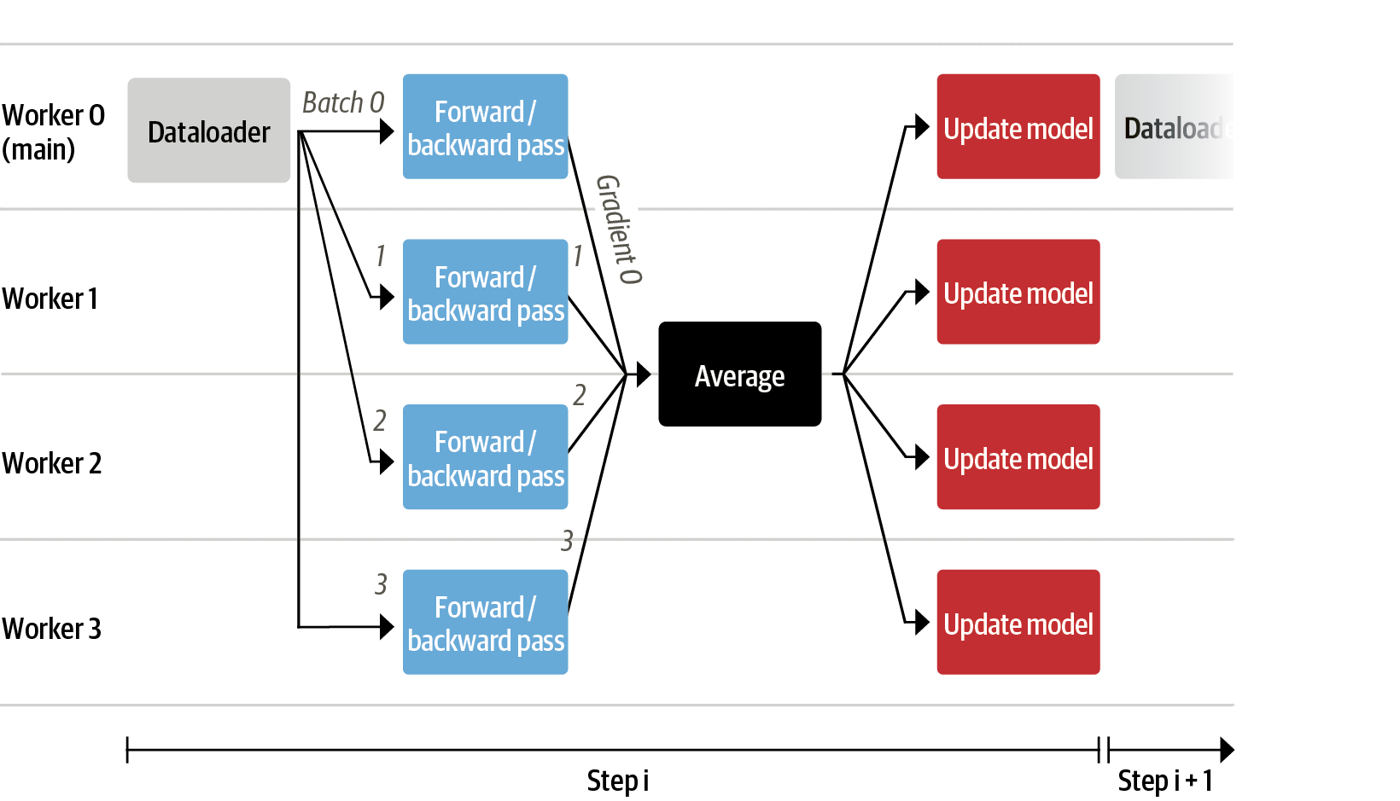
Training a Model from Scratch

Slide 48
Results and Analysis
Code
import re
from transformers import set_seed
from transformers import pipeline
model_ckpt = 'transformersbook/codeparrot-small'
generation = pipeline('text-generation', model=model_ckpt, device=0)
def first_block(string):
return re.split('\nclass|\ndef|\n#|\n@|\nprint|\nif', string)[0].rstrip()
def complete_code(pipe, prompt, max_length=64, num_completions=4, seed=1):
set_seed(seed)
gen_kwargs = {"temperature":0.4, "top_p":0.95, "top_k":0, "num_beams":1,
"do_sample":True,}
code_gens = generation(prompt, num_return_sequences=num_completions,
max_length=max_length, **gen_kwargs)
code_strings = []
for code_gen in code_gens:
generated_code = first_block(code_gen['generated_text'][len(prompt):])
code_strings.append(generated_code)
print(('\n'+'='*80 + '\n').join(code_strings))
prompt = '''def area_of_rectangle(a: float, b: float):
"""Return the area of the rectangle."""'''
complete_code(generation, prompt)

Slide 49
Results and Analysis
Output
return math.sqrt(a * b)
===============================================================================
return a * b / 2.0
===============================================================================
return a * b
===============================================================================
return a * b / a

Slide 50
Results and Analysis
Code
prompt = '''def get_urls_from_html(html):
"""Get all embedded URLs in a HTML string."""'''
complete_code(generation, prompt)
Output
if not html:
return []
return [url for url in re.findall(r'<a href="(/[^/]+/[^"]+?)">', html)]
===============================================================================
return [url for url in re.findall(r'<a href="(.*?)"', html)
if url]
===============================================================================
return [url for url in re.findall(r'<a href="(/.*)",', html)]
===============================================================================
return re.findall(r'<a href="(.*?)" class="url"[^>]*>', html)

Slide 51
Results and Analysis
Code
prompt = '''# a function in native python:
def mean(a):
return sum(a)/len(a)
# the same function using numpy:
import numpy as np
def mean(a):'''
Output
return np.mean(a)
===============================================================================
return np.mean(a)
===============================================================================
return np.mean(a)
===============================================================================
return np.mean(a)

Slide 52
Results and Analysis
Code
prompt = '''X = np.random.randn(100, 100)
y = np.random.randint(0, 1, 100)
# fit random forest classifier with 20 estimators'''
complete_code(generation, prompt, max_length=96)
Output
reg = DummyRegressor()
forest = RandomForestClassifier(n_estimators=20)
forest.fit(X, y)
================================================================================
clf = ExtraTreesClassifier(n_estimators=100, max_features='sqrt')
clf.fit(X, y)
================================================================================
clf = RandomForestClassifier(n_estimators=20, n_jobs=n_jobs, random_state=1)
clf.fit(X, y)
================================================================================
clf = RandomForestClassifier(n_estimators=20)
clf.fit(X, y)

